Slide 1


Green Pace
Security Policy Presentation
Developer: Mitchell Ibarra

Slide 2

OVERVIEW: DEFENSE IN DEPTH
This policy defines the core security principles; C/C++ coding standards; authorization, authentication, and auditing standards; and data encryption standards to ensure consistent implementation of secure principles.

Slide 3
THREATS MATRIX
This threat matrix is populated using the summary of Risk Assessments from the Green Pace Secure Development Policy document.
Likely STD-002-CPP STD-003-CPP STD-004-CPP STD-005-CPP STD-007-CPP STD-008-CPP | Priority STD-002-CPP STD-003-CPP STD-004-CPP STD-005-CPP STD-007-CPP STD-008-CPP STD-009-CPP STD-0010-CPP
Low priority STD-001-CPP | Unlikely STD-001-CPP STD-006-CPP STD-009-CPP STD-0010-CPP

Slide 4
10 PRINCIPLES
Validate Input Data
STD-002-CPP
STD-003-CPP
STD-005-CPP
Heed Compiler Warnings
Architect and Design for Security Policies
STD-006-CPP
STD-007-CPP
STD-008-CPP
STD-010-CPP
Keep It Simple
STD-001-CPP
STD-009-CPP
Default Deny
Adhere to the Principle of Least Privilege
Sanitize Data Sent to Other Systems
STD-004-CPP
Practice Defense in Depth
Use Effective Quality Assurance Techniques
Adopt a Secure Coding Standard

Slide 5
CODING STANDARDS
Data Type - STD-001-CPP
Data Value - STD-002-CPP
String Correctness - STD-003-CPP
SQL Injection - STD-004-CPP
Memory Protection - STD-005-CPP
Assertions - STD-006-CPP
Exceptions - STD-007-CPP
Input/Output - STD-008-CPP
Constructor Initialization - STD-009-CPP
Concurrency - STD-010-CPP

Slide 6
ENCRYPTION POLICIES
Encryption in rest
Designed to prevent attacker from accessing unencrypted data by ensuring the data is encrypted when on a disk. This makes it difficult for an attacker to access data without the encryption key.
Encryption at flight
Encryption of data while being transmitted. Especially with billions of data transfers over networks every day, secure network connections and sending encrypted data ensures that attackers are less likely to be able to access secure data.
Encryption in use
Ensures encryption of data is happening while the data is being accessed. One example is with passwords and the use of hashing to encrypt the password while it is being used to gain access to something.

Slide 7
TRIPLE-A POLICIES
Authentication
This is used to identify a user is who they say they are, typically with login credentials like username and password. Lately, increased authentication has come in the form of multi-factor authentication like providing codes sent to mobile devices that the user owns.
Authorization
This ensures that a user has the proper authority to access certain areas of a system. Certain users will have different roles and should only be allowed to access the minimum amount of a system that they need to perform their role.
Accounting
This is used to keep metrics on how many resources a certain user uses, as analysis can determine whether how many resources the system needs in order to keep a consistent uptime without crashing.

Slide 8
Unit Testing
As a demonstration, we will be looking at Assertions, commonly used in unit testing and how these assertions can be helpful in both testing and ensuring proper data is being used in other applications. This coding standard label is STD-006-CPP.

Slide 9
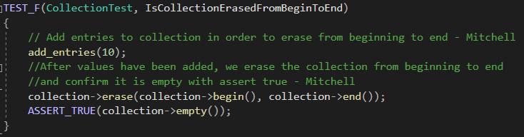
IsCollectionErasedFromBeginToEnd

Slide 10
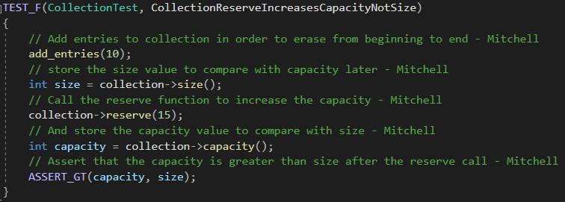
CollectionReserveIncreasesCapacityNotSize

Slide 11
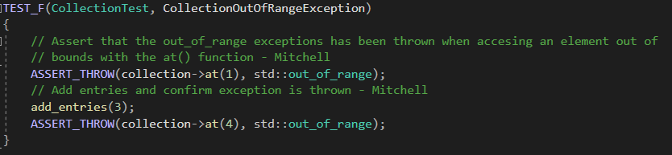
CollectionOutOfRangeException

Slide 12
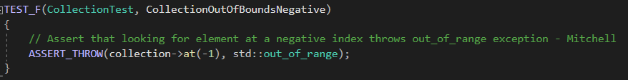
CollectionOutOfBoundsNegative

Slide 13
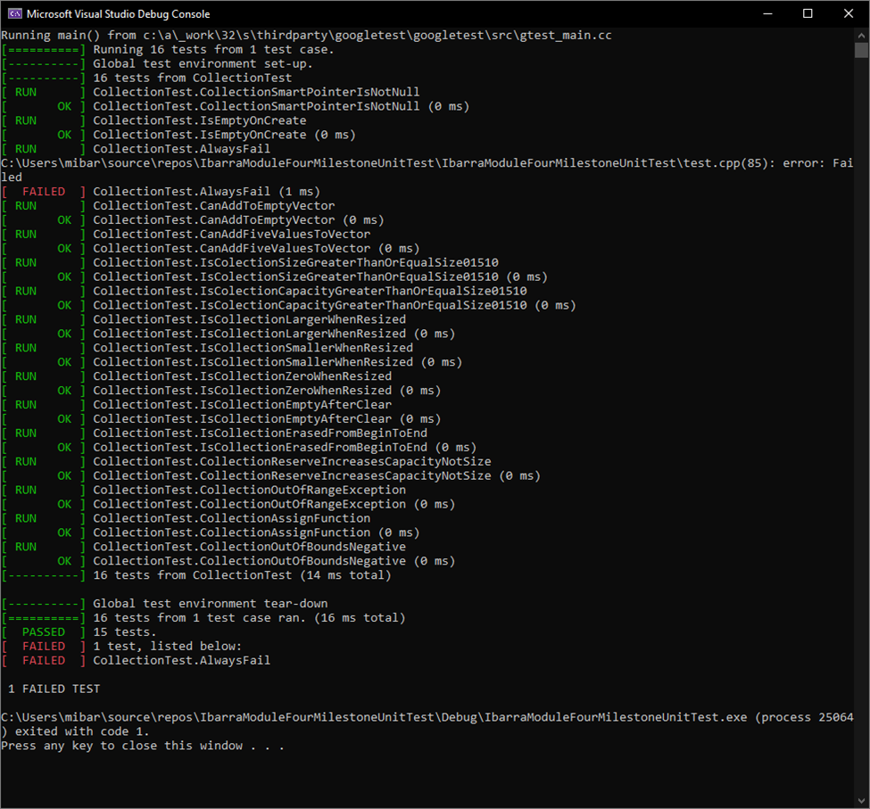
Test Results

Slide 14

AUTOMATION SUMMARY

Slide 15
TOOLS
DevSecOps pipeline refers to integrating security into the software development lifecycle to build, test, and deploy secure software faster and easier. (Foster, 2021)
Tools used include CppCheck and Google Test and CI/CD tools like Jenkins
CppCheck is a static analysis tool to check C/C++ code for common errors and coding standards.
Google test automates C++ unit tests with user defined assertions, value parameterized, and type parameterized tests.
Jenkins continuous integration tool can automate unit tests
These tools are used all throughout the pre-production stages of the DevSecOps Pipeline to ensure proper coding standards and best secure practices are constantly being followed

Slide 16
RISKS AND BENEFITS
The solutions that this plan solves is getting an early and proactive start in implementing secure coding standards to ensure security is incorporated in the design from the beginning
By doing so, we reduce the errors that can occur via logical errors or insecure coding practices that can lead to devastating breakdowns of infrastructure or attacks by hackers looking to damage the company or extort money from Green Pace

Slide 17
RECOMMENDATIONS
This strategy still requires tools to monitor and perform health checks of systems like Azure DevOps or GitLab to support collaboration between Development, Security and Ops teams
Some risks of using this strategy include slower development process inherently due to the nature or constantly testing and performing code reviews
Agile methodologies can help streamline the development process and Agile tools like Jira/Confluence and others can support this methodology
This article provides further information on how Agile can make the development process more efficient: https://angel.co/blog/agile-methodology-a-primer-on-moving-fast
Using the example of Equifax’s data breach in 2017, a consumer complaint web portal with a known vulnerability was exploited and resulted in the breach of millions of people’s data and credit information. This can easily be avoided by having a system in place that promotes and supports continuous deployment of security patches
Learn more about the Equifax data breach here: https://www.csoonline.com/article/3444488/equifax-data-breach-faq-what-happened-who-was-affected-what-was-the-impact.html#toc-1

Slide 18
CONCLUSIONS
Continue to practice and implement CERT C++ Secure Coding Standards
Track software vulnerabilities found in testing with issue tracking tools like Jira
Provide tools to report vulnerabilities found in legacy code still in use so that plans can be created to patch the vulnerabilities
Create AI tools to help scan for and if necessary, report or implement secure coding practices in areas
Utilize outside sources such as white hat hacking companies to find vulnerabilities in our software

Slide 19
REFERENCES
Foster, S. (2021, January 22). DevSecOps Pipeline Overview: DevSecOps Simplified. Perforce Software. https://www.perforce.com/blog/kw/devsecops-pipeline-overview.

